Slide 1
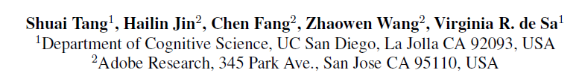
Rethinking Skip-thought: A Neighborhood based Approach
Workshop on Representation Learning for NLP
Reporter: Lao Yadi

Slide 2
Background
Task: sentence representation
Method:
Composition of learned word representation
Train for supervised task
Skip-thought vector model
...

Slide 3

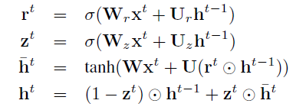
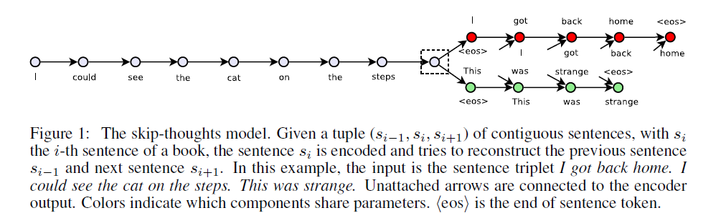
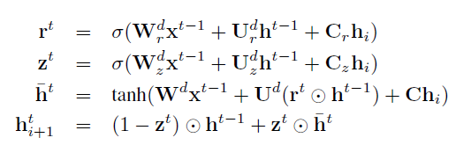
Skip-thought vector model (Kiros et al., NIPS 2015)
Use seq2seq as backbone to predict previous and next sentences.
Objective function
Encoder
Decoder
Notes:
Skip gram思想
两个不同的decoder，2个不同的分布

Slide 4
Skip-thought neighbor model
Motivation
The adjacent sentence provide the same neighborhood information.
Incorporate an autoencoder path.

Slide 5
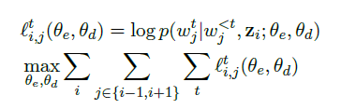
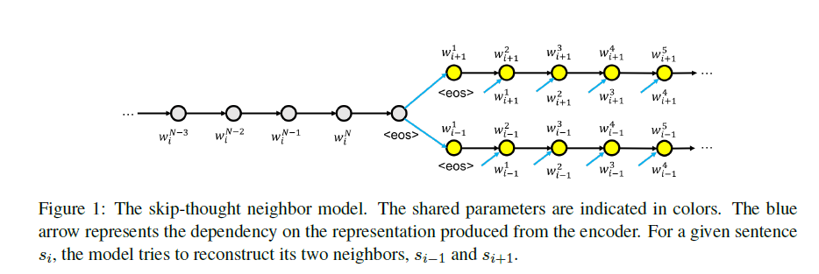
Skip-thought neighbor model
Encoder = GRU
Decoder = conditional GRU (share parameter)
Objective function

Slide 6

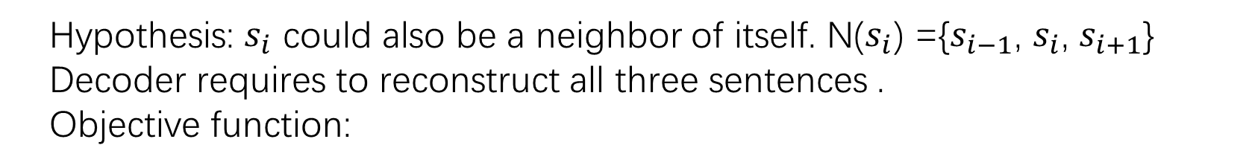
Skip-thought neighbor model with Autoencoder
Hypothesis: $s_{i}$ could also be a neighbor of itself. N($s_{i}$) ={$s_{i−1}$, $s_{i}$, $s_{i+1}$}
Decoder requires to reconstruct all three sentences .
Objective function:

Slide 7

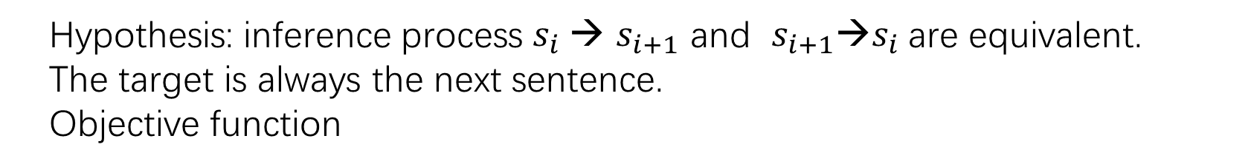
Skip-thought neighbor model with One Target
Hypothesis: inference process $s_{i} →$ $s_{i+1}$ and $s_{i+1}→s_{i}$are equivalent.
The target is always the next sentence.
Objective function

Slide 8
Experiment
Unsupervised Training
BookCorpus, 74 million sentences
Quantitative Evaluation
Semantic relatedness → SICK
Paraphrase detection → Microsoft Paraphrase Detection
Question type classification
4 benchmark sentiment and subjective datasets.
TREC, movie review sentiment(MR), customer product reviews(CR), subjectivity/objectivity classification(SUBJ), opinion polarity(MPQA)
Qualitative Evaluation
Sentence retrieval
Conditional sentence generation

Slide 9
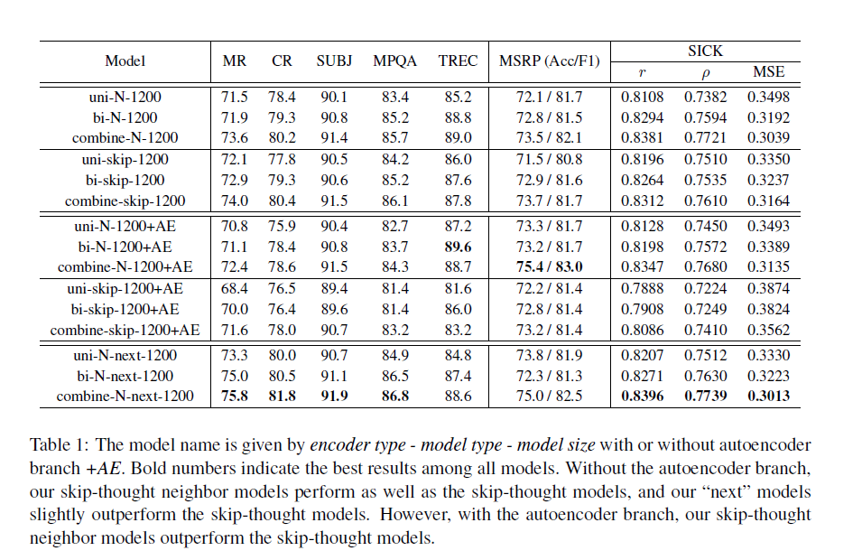
Quantitative Result
Notes:
Our model has fewer parameter
Our model + AE > skip thought + AE > skip thought
Our model with Next best

Slide 10
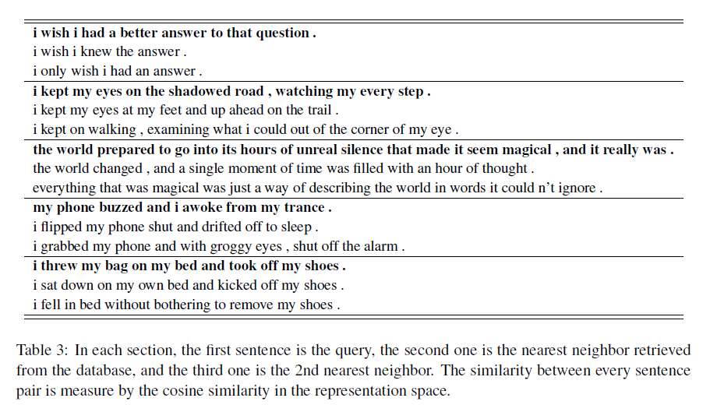
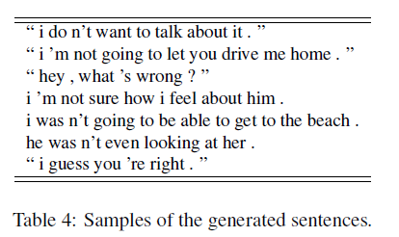
Qualitative Result
Sentence retrieval
Conditional sentence generation

Slide 11
Conclusion
Our models perform as well as the skip-thought models for 7 tasks.
Our model with one target performs better
Generalization on larger dataset

